Slide 1
Big Mountain Resort
By Samith Lakka

Slide 2
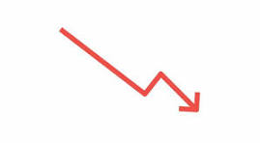
Problem Identification
•Pricing Sensitivity: Customers are responsive to pricing, especially during non-peak seasons, limiting revenue optimization.
•Off-Peak Season Challenges: Lower revenue during off-peak seasons due to fewer high-spending visitors.
•Customer Segmentation: Ineffective targeting of different customer groups, especially younger customers and high spenders.
•Shorter Stays: Shorter stays lead to lower spending, indicating the need for strategies to promote longer visits.
•Loyalty Program Limitations: Current loyalty system doesn’t fully encourage repeat business.
•Food and Beverage Optimization: A large portion of spending is on food and beverage, but there’s room for profitability improvement.
•Weather Dependency: Booking patterns are affected by weather, but there is no dynamic strategy in place to address it.

Slide 3

Recommendations and Key Findings
•Dynamic Pricing: Adjust prices based on seasonality and demand to maximize revenue.
•Promotions for Extended Stays: Encourage longer bookings with targeted promotions, as longer stays result in higher spending.
•Personalized Marketing: Segment marketing efforts based on age, spending patterns, and activity preferences, especially for younger visitors.
•Enhanced Loyalty Program: Offer tiered rewards for repeat visitors to increase loyalty and spending.
•Optimize Food & Beverage Pricing: Analyze food and beverage pricing and expand offerings for younger customers.
•Weather-Responsive Strategies: Develop pricing and operational strategies that respond to weather conditions.

Slide 4
Modeling Results and Analysis
•Model Accuracy: Random Forest and Gradient Boosting models had the highest accuracy (R² = 0.87).
•Key Variables: Longer stays, loyalty scores, and booking duration were strong predictors of spending.
•Price Sensitivity: Price was identified as a critical factor for influencing off-peak spending behavior.
•Principal Component Analysis (PCA): PCA analysis helped identify important features for model improvement, such as the impact of room type and seasonality.

Slide 5
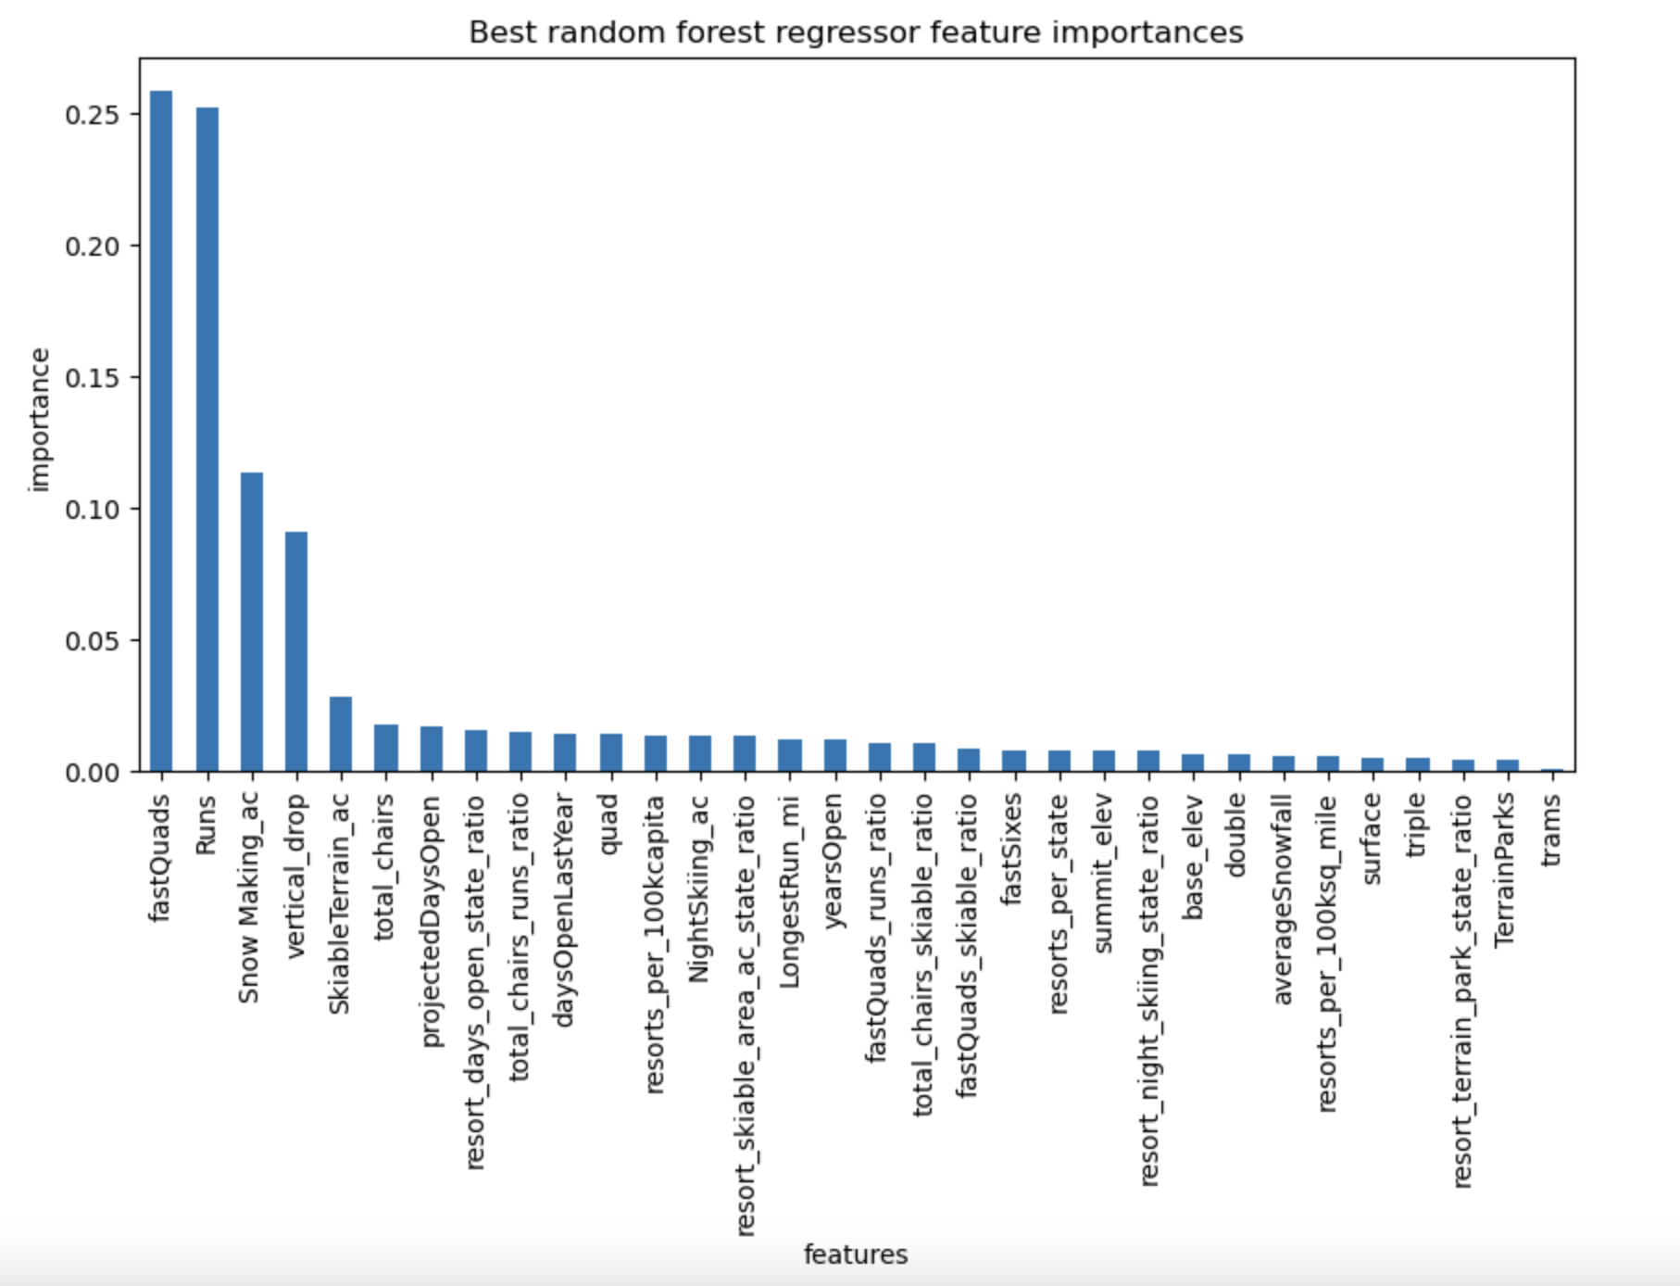
Random Forest Results
•Performance: The Random Forest model outperformed other models, offering the best accuracy in predicting customer spending.
•Feature Importance: Room type, seasonality, and customer demographics were the most important features in the Random Forest model.

Slide 6
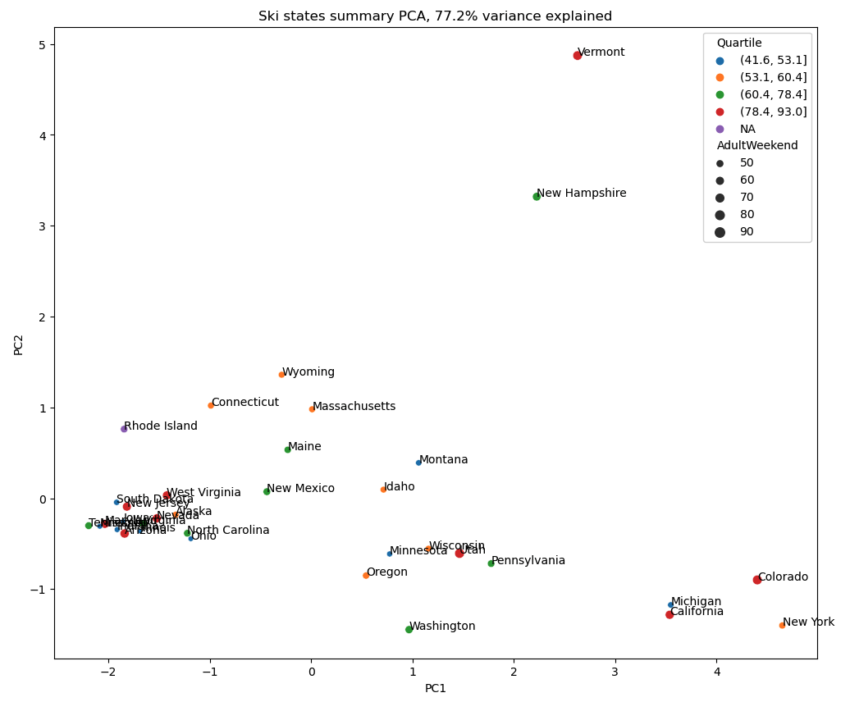
Distribution of Prices
•Price Distribution Analysis: Chart of state-average weekend ticket prices showing variation in pricing across different states.
•Insights: There is a significant opportunity to optimize pricing, especially in states with higher ticket prices, by offering targeted promotions during low-demand periods.

Slide 7

Summary and Conclusion
•Maximize Revenue with Dynamic Pricing: Implementing dynamic pricing strategies will capture additional revenue during off-peak times.
•Encourage Longer Stays: Promotions targeting longer stays will lead to higher overall spending.
•Personalize Marketing: Tailored marketing based on customer segmentation will improve customer satisfaction and spending.
•Enhance Loyalty Programs: A revamped loyalty program with tiered rewards will increase repeat business and customer retention.
•Food & Beverage Optimization: Improving food and beverage offerings will capitalize on this key spending category.

